Slide 1

Psychology Presentation

Slide 2
Hypothesis
People living in old age homes are DEPRESSED.

Slide 3
Group Members
Muhammad Zain
(Psychological Effects
&
Literature Review)
Talha Shabbir
(Statistical Analysis)
Saad Akbar
(Conclusion)
Ahmed Mushtaq
(Discussion & Limitations)
Imran Malik
(Impact on Behaviour)
Abdul Majid
(Recommendations)
Rabiya Adnan
(Introduction)

Slide 4


Slide 5
Rabiya Adnan
5

Slide 6
Introduction
6

Slide 7
Depression: A mental illness, which negatively affects the way you think, feel and act
Family considered to be the primary source of love, care and affection
With the passage of time, there has been an increase in the number of old age homes
Research conducted by Rosevinge suggested around 10-19% people from the general population suffered from depression
The elderly constitute the fastest growing population, and with depression being the most common psychiatric disorder, the future costs of depression to the patient, health care officials and the carer will be significant

Slide 8
Muhammad Zain
8

Slide 9
Psychological Effects of living in
Old age homes
9

Slide 10
Prolonged stay at the old age home often results in loneliness, which may lead to depression
Loneliness sometimes considered to be the root cause of depression
Owing to severed family ties, the residents feel like social outcasts
Loss of interest in activities
Lack participation in activities
Avoid talking about their past
Do not like interacting with others, and some avoid meeting relatives as well
Have to adapt to new environments, which may be hard to do for some

Slide 11
Literature Review
11

Slide 12
Dr. Pragna Parikh
Comparative Research in India (Depression Scale) on 120 people.
Considerably higher depression in old age home residents.
Because of economic and social complicatedness
Tam & Chiu(2011)
Mental illness, such as depression, cause deterioration of health.
Scratch & Beag(1984)
Mental well-being of in the old age homes is mainly owing to loneliness.
Dhilon & Samanth(1992)
Loneliness is highly related to frustration, depression, and desperation.
Loneliness coupled with an inactive social life, cause of health problems.
Richman & Frendy(1998)
Majority of mental health issues among the elderly are due to loneliness.
Jorunn Drageset, Elin Dysvik, Birgitte Espehaug, Gerd Karin Natvig, and Bodil Furnes
To determine levels of stress and depression.
Depression because of their limited emotional roles.

Slide 13
Ahmad Mushtaq
13

Slide 14
Discussion
14

Slide 15
Purpose was to evaluate the psychological conditions of people living in the old age homes.
We visited Dar-ul-kufala (Bagh-e-Rehmet).
Questionnaires conducted among 20 males and 30 females with age range of 60 to 89.
We collected data through questionnaires, then analyzed and gathered into tables.
We also recorded their interviews.

Slide 16
Limitations
16

Slide 17
Permission issues from old age homes.
Hectic Travel.
Problems in interacting with old women.
Language barriers.
Being careful not to hurt them.
Some residents did not want to talk about their past.
Permission issues for recording their videos during interviews.

Slide 18
Talha Chaudhry
18

Slide 19
Statistical Analysis
19

Slide 20
Overall Percentage Findings

Slide 21
Do you lack Excitement on occasions like EID?
YES
NO
82%
18%
90% Male
10% Male
83% Female
17% Female

Slide 22
Do you want the time to pass by
As soon as possible?
YES
NO
78%
22%
70% Male
30% Male
66% Female
34% Female

Slide 23
Imran Malik
23

Slide 24
Impact on Behaviour
24

Slide 25
Isolation
Many of the residents we interviewed were prone to isolation. Meaning they didn’t want anyone to find out about them.
Lethargy
The residents showed many signs of lethargy. They spoke slowly as if they had a burden on their shoulders. Some of the samples didn’t even left their rooms.
Pessimism
Their words indicated high degree of pessimism. They had negative feelings about the things around them.
Worthlessness
Their words and behavior indicated they felt as if there was no need of them in the world now and there mere existence was a burden to the society.
Helplessness
Most of the residents didn’t have anyone to take care (Children) of them which is why they moved to an Old Age Home. This feeling was still inside their hearts.
Low self-esteem
Worthlessness and Helplessness also fueled their low self-esteem. Therefore they had socially withdrawn themselves.
Preoccupation with death, dying, suicide
Although we are Muslims and suicide is HARAM for us. But if a person is under depression he/she cannot stop the feelings and thoughts about death.

Slide 26
Saad Akbar
26

Slide 27
Conclusion
27

Slide 28
We have failed terribly as a nation. Having so many Old age homes in just one city and all have a lot of old people waiting to be admitted.
74% agreeing to the fact that they are depressed and 26% are definitely hiding their tears inside because they seemed no less depressed.
Someone quoted this old age home to be his “Jannat”, imagine how is life must have been before coming here.
Despite good facilities in the old age homes, people there are not happy enough.
Hopeful people had more depression than hopeless people. Hopeless ones had given up and accepted old age home to be their home.
These people had mostly no interests in any festivals like Eid.
The only complain they had regarding visitors was that visitors remind them of their past over and over. They find this selfish and want the visitors to stop doing research or at least stop forcing their questions.

Slide 29
Abdul Majid
29

Slide 30
Recommendations
30

Slide 31
Taking their consent before asking them about their lives.
To empathize instead of sympathizing.
Raising funds and installing better equipment.
Arranging movie nights and trips for the residents.
Ethical and religious duties of citizens.

Slide 32
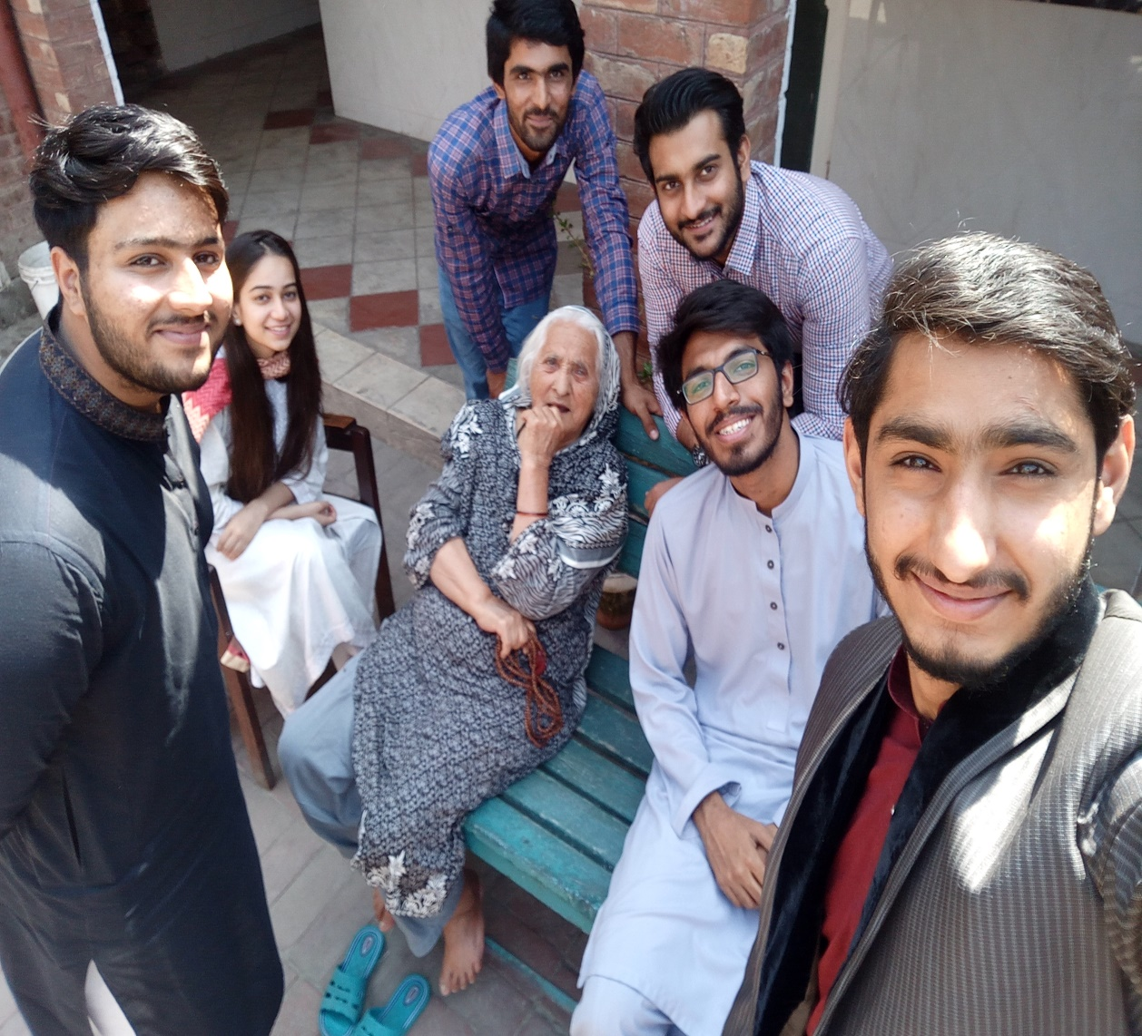
Thank You

